Slide 1





5G Radio Access – Network Architecture
SO – Service Orchestrator
SDN-C – Service Design Network Controller
DCA&E – Data Collection Analytics & Events
A&AI – Available & Active Inventory
APP-C – Application Control
ONAP Run Time Management
OSS
BSS
SO
SDN-C
DCAE
A&AI
APP-C
5G
Application
Ecosystem
RAN Network Elements
Core Network Elements
CU-CP-H
Disaggregated Core
Antenna
5G
Base Station
UPF
SMF
UDM
AUSF
CU-CP-L
RU
DU
CU-UP
Edge
Cloud
Back Haul
Centralized
Cloud
Internet
Front Haul
Mid Haul
External Content
UE
RU – Remote Radio Unit
DU – Distributed Unit (5G Base Unit)
CU-UP – Centralized User Plane
CU-CP – Centralized Control Plane (low and high)
UPF – User Plane Function
SMF – Session Management Function
UDM – Unified Data Management Function
AUSF – Authentication Service Function

Slide 2
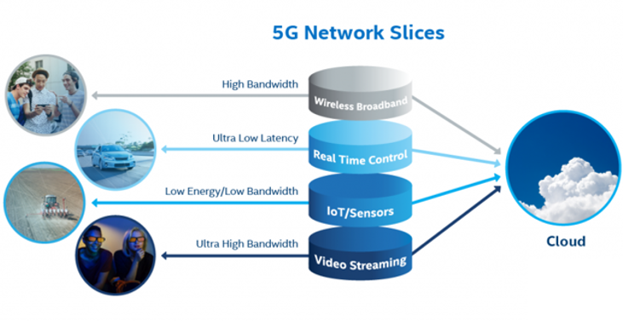




5G Network Slices (Example)

Slide 3
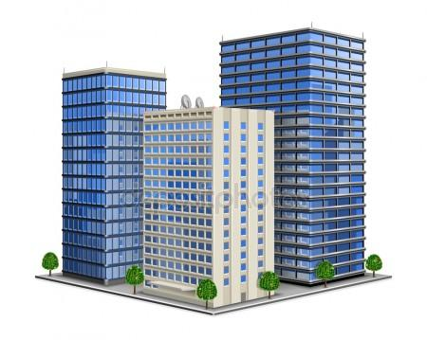

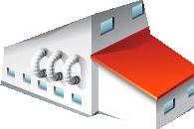
Customized Horizontal & Vertical Slices
VERTICAL SLICE
Subscriber #1
Subscriber #2
Subscriber #1’s Wireless Broadband Slice
Customizations of the “general” Wireless broadband slice. Customized for particular monitoring
Subscriber #2’s Wireless Broadband Slice
Customizations of the “general” Wireless broadband slice. Is hosting a general assembly meeting and wants more dedicated wireless broadband usage.
Wireless Broadband
Subscriber #1’s Real-Time Control Slice
Customizations of the “general” Wireless Real-Time Control slice. Installed with specialized Subscriber vehicular controls
Subscriber #2’s Real-Time Control Slice
Customizations of the “general” Wireless Real-Time Control slice. Is testing a trial prototype proof of concept vehicular control platform.
Real-Time Control
HORIZONTAL SLICE
Subscriber #1’s IoT Slice
Customizations of the “general” Wireless IoT slice. Security Sensors tailored to the unique location of the Subscriber.
Subscriber #2’s IoT Slice
Customizations of the “general” Wireless IoT slice. Has recently installed IoT sensors in their HVAC systems.
IoT Sensors
Subscriber #1’s Video Streaming Slice
Customizations of the “general” Wireless Video Streaming slice. Currently is using a training video to all employees.
Subscriber #2’s Video Streaming Slice
Customizations of the “general” Wireless Video Streaming slice. Is currently setting up a video streaming slice for their CEO to give a presentation.
Video Streaming

Slide 4
Slice Groups
VERTICAL SLICE
VERTICAL SLICE
VERTICAL SLICES (examples):
-Hospitals,
-Companies,
-Airports
-Stadium
-University Campus
-Disaster Area or Security forces
-Regional Trials
-High Density Urban Community
-Railway
HORIZONTAL SLICES (examples):
Wireless Broadband
Real-Time Control
IoT & Sensors
Video Streaming
5G AVANTAGE OVER 4G:
End to End Accounting
Built in to 5G framework (report, verify, account)
FUNCTIONALLY:
NSSP configures device.
NSSP Maps applications to Slices
A valid slice over multiple RegAreas would have
Valid NSSAIs in multiple RegAreas
HORIZONTAL SLICE
Subscriber #1
Subscriber #2
Wireless Broadband
Cell #1
Cell #1
Cell #2
Cell #2
Real-Time Control
Tracking Area #1
Tracking Area #1
IoT Sensors
Registration Area #1
Registration Area #1
Video Streaming

Slide 5
Slice within a Tracking Area
OPERATION:
- A slice must be consistent throughout a Tracking Area (e.g. the Real-Time Control Slice is the same for the UE throughout the Tracking Area #1)
- A slice must be consistent for all of the Cells that comprise a Tracking Area.
- Slices are only valid within the PLMN.
- NSSAI (Network Slice Selection Assistance Information) are PLMN specific
- Two PLMNs have NSSAI independent of each other.
REGISTRATION AREAS:
- Registration Areas are tied to NSSAI
- UE registers with AMF (which provides the UE with the TAI and thus the registration area it is in)
- Note: Cells don’t announce slices
- If you stay within the Registration Area the NSSAI is valid.
CONFIGURATION
- Core control is done in CU, CallP is in CU.
- “Race condition” of CU provisioning
- Slice supported in a TA List
- Configuration, Activation/Operation
Cell #1
Real-Time Control Slice
Cell #2
Tracking Area #1
Real-Time Control Slice
Registration Area #1
PLMN

Slide 6


Slicing “Costs”
Slice “Costs”
There are “costs” (OPEX, CAPEX) associated with Slices
TOPIC | DESCRIPTION
Counters / KPIs | Performance measurements & monitoring of slices
Definition, Network Provisioning | Defining parameters for operation of slices and RA/TA Configuration
Network Standardization | Network usage and corporate communication
Instantiating Slices | Maintenance of slices and “cataloging” slices & SLAs
Cell #1
Tracking Area
Cell #2
Registration
Area
Cell #n
Tracking Area

Slide 7

Call Flow Details
3GPP TS 23.501
Actors
Systems of interface
Demand Forecast
Resource Management
Load Optimizer
RAN Slice Allocation
Subscriber 1
Resource Admin
5GC, 5G-RAN
Subscriber 2
1a. Demand Forecast
1b. Demand Forecast
2a. Resource request
S-NSSAI -RRC Setup
2b. Resource request
S-NSSAI -RRC Setup
2c. Consolidate the request
3a. Send details to optimizer
4a. New Distributed Load
5a.Communicate to the subscribers
5b.Communicate to the subscribers
6a. Changes in the RAN Slice
6b. Confirm request to Subscribers
6c. Confirm request to Subscribers
S-NSSAI -RRC Complete
S-NSSAI -RRC Complete

Slide 8
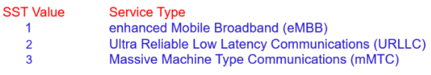
https://www.techplayon.com/5g-ran-and-5gc-network-slice-signaling/
Dataset Refence
SST: It refers to the expected Network Slice behavior in terms of features and services
Slice Differentiator (SD): It is an optional information that complements the Slice/Service type(s) to differentiate amongst multiple Network Slices of the same Slice/Service type.

